Slide 1
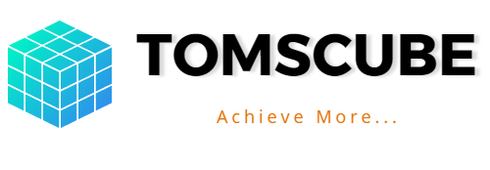

Business Management Software Solution for Small & Big Enterprises
A presentation by BisCom TDigits Ltd.
Email: info@biscomtdigits.com
Telephone: 09086315784, 08181489441

Slide 2
DO EVERYTHING WITH TOMSCUBE
TOMSCUBE is a one office management software solution that is carefully designed to automate and simplify crucial aspects of your everyday office operations.
Manage Expenses. Minimize cost on operations. Monitor Staff Performance. Generate Reports. Track files. Assign tasks. Manage Projects and Assets.

Slide 3
Features of TOMSCUBE
1. HR And ADMIN module
Payroll processing
Personnel records management
2. Document & File Manager
3. Expense Manager
4. Equipment Manager
5. Task Management
User-performance & KPI Report
6. Marketing Module
Customer/Clients Relations Manager
Activity reminder
7. Dashboard: Executive, Staff and Projects

Slide 4
Benefits of Tomscube
Shows you cost saving opportunities via trends analysis on dashboard.
Reduces tons of paperwork when your staff and managers digitally assign their workload on the task manager.
Eliminates human errors by handling your expense reports with the expense manager.
Manages and tracks the status of your assets with the asset diary.

Slide 5
HR and Admin Tools
The HR and Admin tools help the Human resource personnel to:
Manage staff records and files with the electronic document library and files manager
Digital attendance register alerts managers on attendance for the day.
Process payrolls, staff leave and loans in minutes
Organize and prepare recruitment profiles of job candidates before interviews

Slide 6
Document/File Manager
Tomscube has a paperless Document Management System that:
Stores the digital content of all your company’s documents and files types
Provides a Search field to easily track and locate files using keywords and categories
Security and access control over organization’s documents.

Slide 7
Equipment Manager
Inventory to Track equipment location.
Maintenance log with reports on repairs and equipment status via email.
History statistics on equipment
Updates on work orders received on equipment.

Slide 8
Dashboard
The dashboard allows your executives and staff to access reports and trends pertaining to their key areas of interests and concerns.
CEOs, CFOs, Project Managers, etc. can see company situations that affect their departments and respond accordingly.

Slide 9
Executive Dashboard
The executive dashboard displays your company’s performance data from different departments on colorful analytical charts for executives and managers to interpret and make quick decisions.
The executive dashboard gives CEOs and other Senior executives a bird view of all the company’s activities.

Slide 10
Project Dashboard
The project dashboard organizes all project data from different sources and interprets them for project executives’ convenience.
It simplifies the complexities of projects with detailed analysis on workers activities, project progress, cost information and time spent.
Notifies executives and team members on project areas that matter to them.

Slide 11
The Expense Manager
The expense manager records expenses and generates reports that are easily exported in different formats such as PDF or CSV
Compares expense records between periods and measures how much is spent on operations.
Locates trends like periods when expense peak the most, so you can prepare cash to be ready in these times using the CASH ADVANCE tool.

Slide 12
Task Management Module
Tomscube has a task manager that:
Enables managers to automatically assign or delegate work to employees
Tracks and manages each department's tasks with custom workflows & visual overviews
Evaluates staff performance in real time, quickly highlights underperforming staff
Safely stores documents and secures sensitive files.

Slide 13
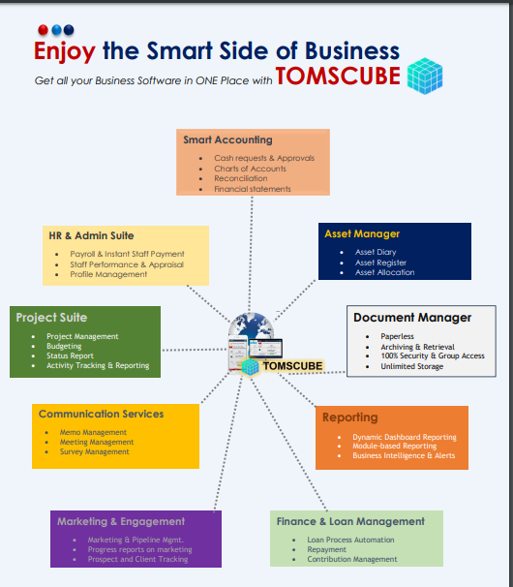

Slide 14
WELCOME ONBOARD

